Slide 1
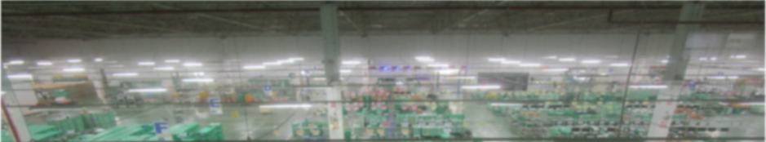
LCA
Rec.
SM
IM
D
omestic
B
C
utsuryu
ontrol
HOME
About us 
ISO Document 
Activity 
IT Project 
Inventory control
- Daily stock
- Report
Store control
- Layout
- Report
Admin & Defect control
- ECN
- MT
- EOL
- Report
Milk run
- Supplier milkrun
- Report
Package
- Stock control
- Report

Slide 2
